Slide 1

Chapter 7
Transmission Media
7.<number>
Copyright © The McGraw-Hill Companies, Inc. Permission required for reproduction or display.

Slide 2
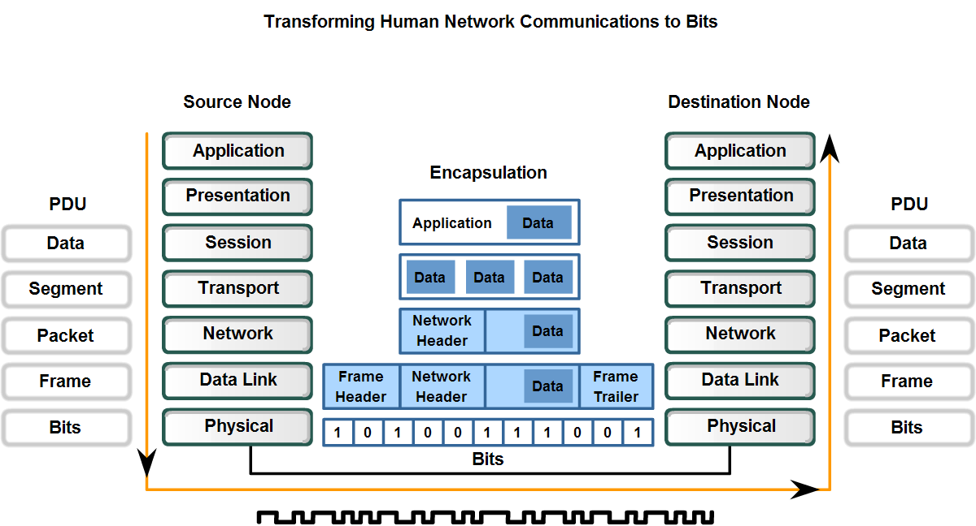
Physical Layer
The purpose of the Physical layer is to create the electrical, optical, or microwave signal that represents the bits in each frame.

Slide 3

Figure 7.1 Transmission medium and physical layer
Transmission media are located below the physical layer and directly controlled by the physical layer.
7.<number>

Slide 4
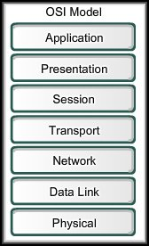
Physical Layer Elements
Requires:
  Primary Purpose:
  A representation of the bits of a
  frame on the media in the form
  of signals.
  The physical media and associated
  connectors.
  Encoding of data and control
  information.
  Transmitter and receiver circuitry
  on the network devices.

Slide 5
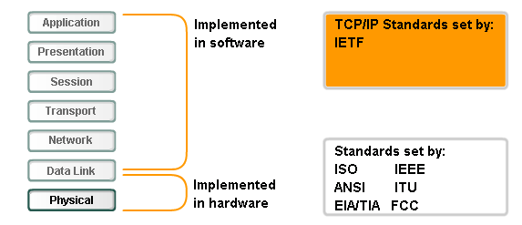
Standards
Physical layer standards:
  Physical and electrical properties of the media
  Mechanical properties (materials, dimensions, pinouts) of the connectors
  Bit representation by the signals (encoding)
  Definition of control information signals

Slide 6
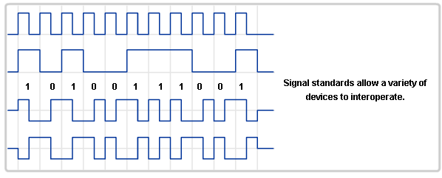
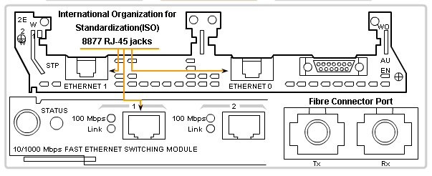
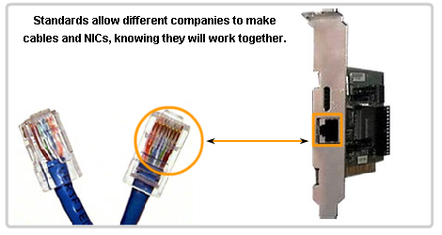
Standards
Signals
Connectors
Cables

Slide 7

Figure 7.2 Classes of transmission media
7.<number>

Slide 8
7-1 GUIDED MEDIA
Guided media, which are those that provide a conduit from one device to another, include twisted-pair cable, coaxial cable, and fiber-optic cable.
Topics discussed in this section:
Twisted-Pair Cable
Coaxial Cable
Fiber-Optic Cable
7.<number>

Slide 9
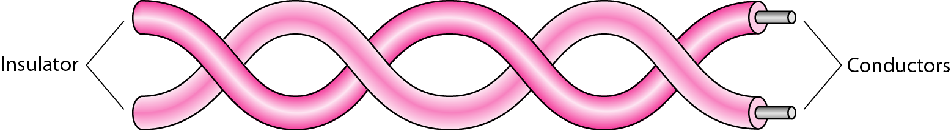
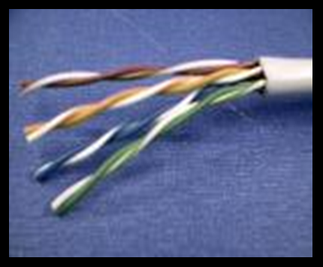
Figure 7.3 Twisted-pair cable
Two separately insulated copper wires twisted together
Often “bundled” into cables.
7.<number>

Slide 10
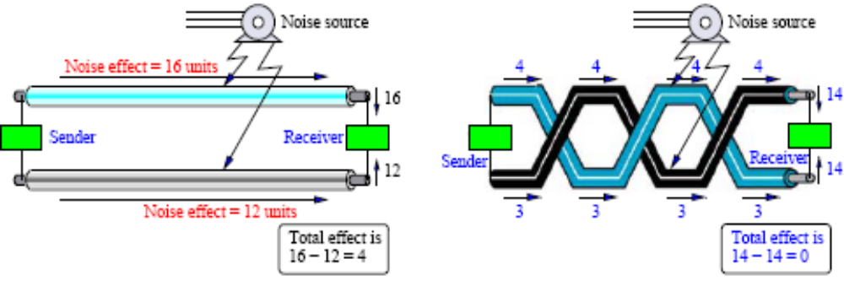
Effect of Noise on Parallel and Twisted-Pair Lines
Twisting allows each wire to have approximately the same noise level and reduces crosstalk.

Slide 11

Figure 7.4 UTP and STP cables
7.<number>

Slide 12

Table 7.1 Categories of unshielded twisted-pair cables
7.<number>

Slide 13

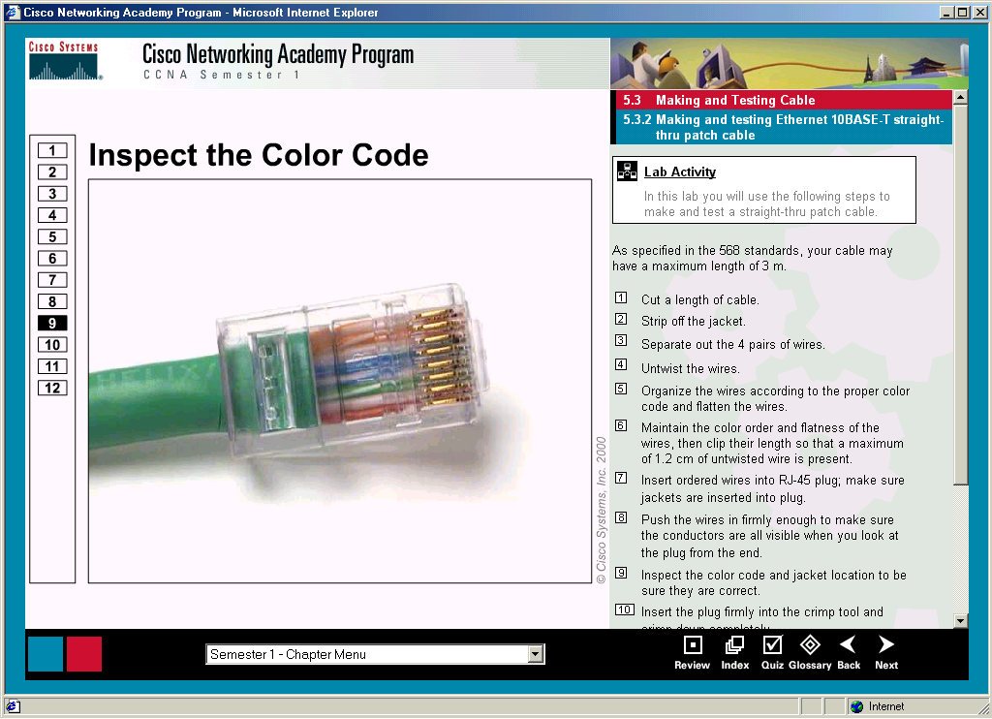
Figure 7.5 UTP connector
7.<number>

Slide 14
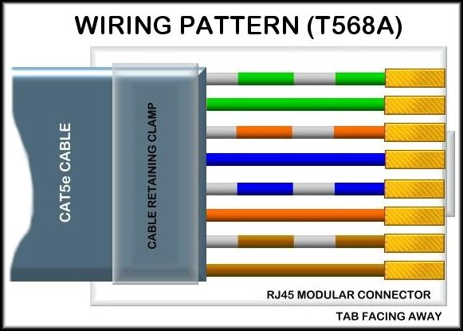
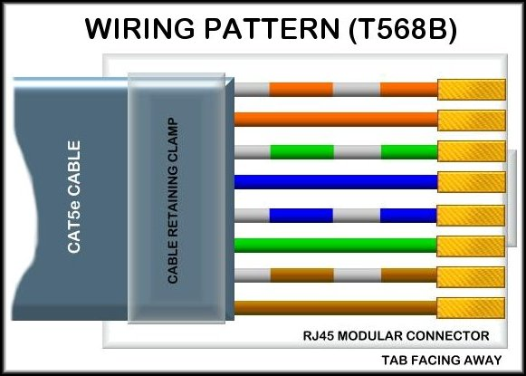
UTP Cable
Wiring Patterns:
  There are two specific TIA/EIA standard wiring patterns:

Slide 15
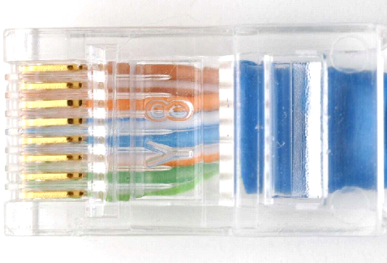
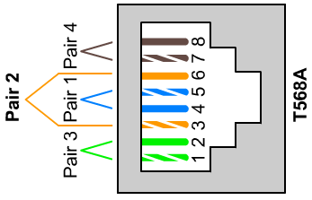
This is the Jack
This is the Connector
568A

Slide 16
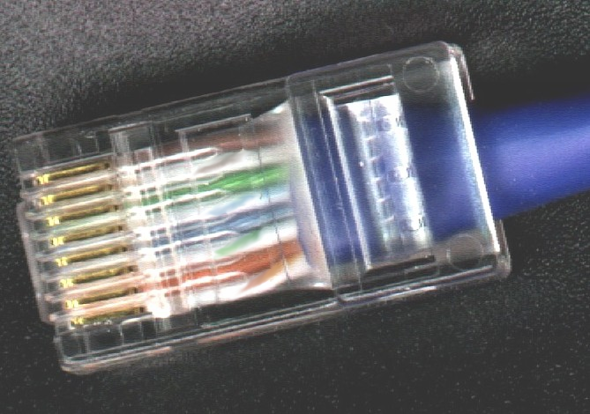
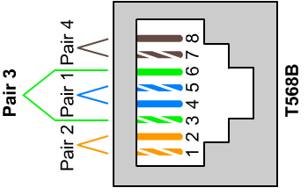
This is the Jack
This is the Connector
568B

Slide 17
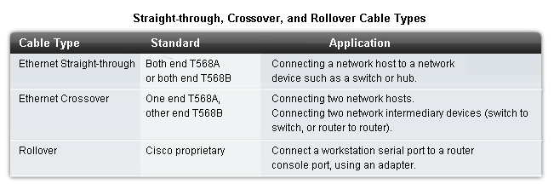
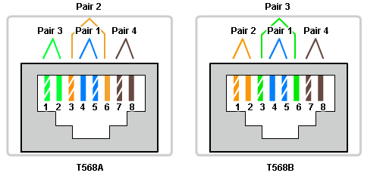
UTP Cable Types
Different situations may require UTP cables to be wired according to different wiring patterns:

Slide 18
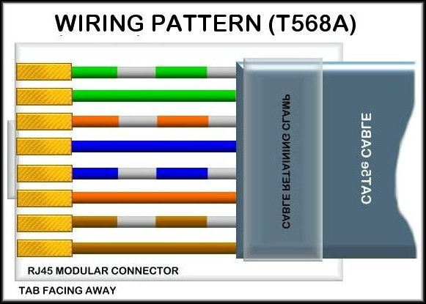
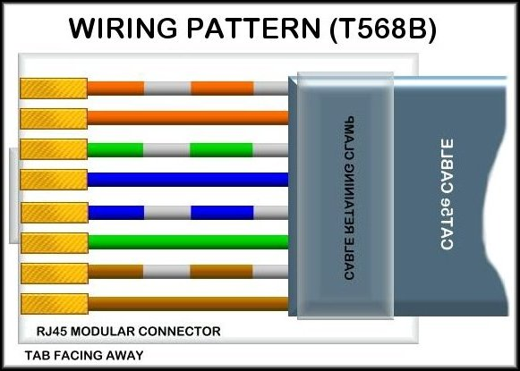
UTP Cable Types
Ethernet Straight-through:
  T568A or T568B may be used as long as the same pattern is used at both ends of the cable.
Connecting a device to a switch or hub.

Slide 19
UTP Cable Types
Ethernet Crossover:
  T568A and T568B are used at either end of the cable.
  Connecting two workstations together.
  Connecting two networking devices.
    Switch to a switch
    Router to a router

Slide 20
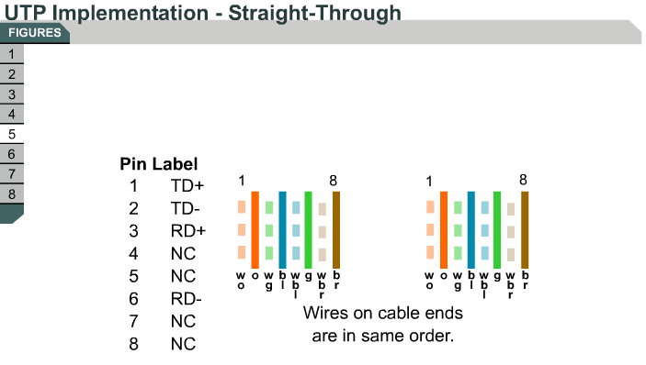

Slide 21
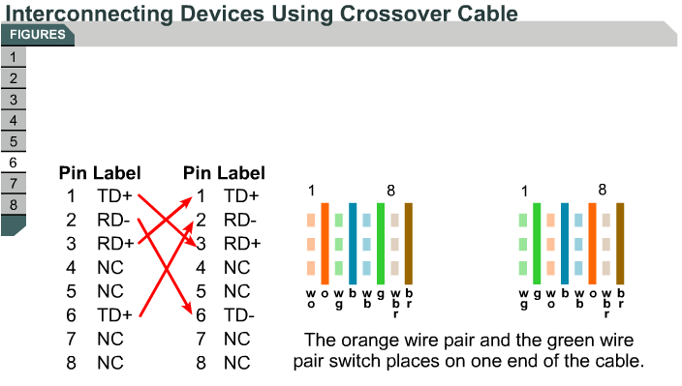

Slide 22
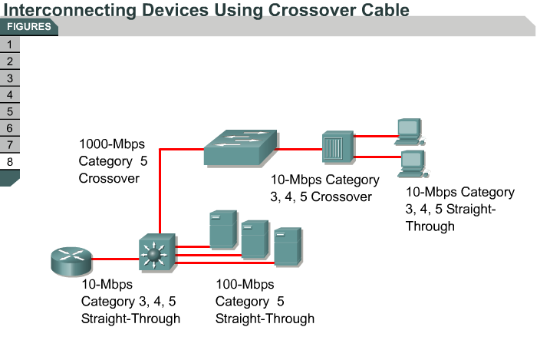
Use straight-through cables for…
Switch to router
Switch to PC or server
Hub to PC or server
Use crossover cables for…
Switch to switch
Switch to hub
Hub to hub
Router to router
PC to PC
Router to PC

Slide 23

Figure 7.6 UTP performance
7.<number>

Slide 24
Twisted Pair
Applications:
  Most common medium
  Telephone network
    Between house and local exchange (subscriber loop)
  Within buildings
    To private branch exchange (PBX)
  For local area networks (LAN)
    10Mbps ,100Mbps, 1Gbps
Pros
  Cheap and easy to work with
Cons
  Low data rate and short range

Slide 25

Figure 7.7 Coaxial cable
7.<number>

Slide 26

Table 7.2 Categories of coaxial cables
7.<number>

Slide 27

Figure 7.8 BNC connectors
7.<number>

Slide 28

Figure 7.9 Coaxial cable performance
7.<number>

Slide 29
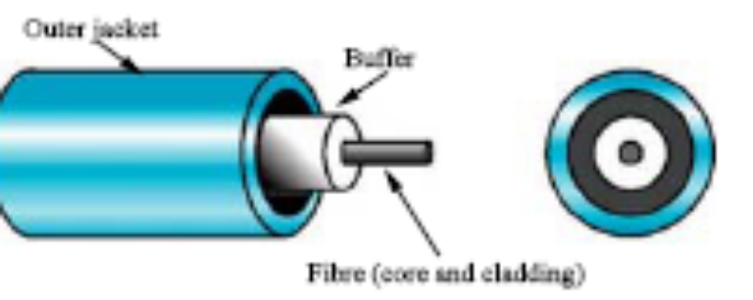
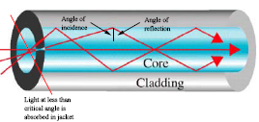
Fiber Optic Cable
Physical description:
  Fiber optic cable is made of glass/plastic and transmit signal in form of light
  Optical Signal is carried by photon pulses through thin (8 to 10 microns) glass strands (optical fibers)
  light waves are produced either by Light emitting diodes (LEDs) or injection laser diode (ILD).
  at transmitting and receiving end, signal is converted from and reconverted to electrical form by optical modems such as an avalanche photo diode.

Slide 30
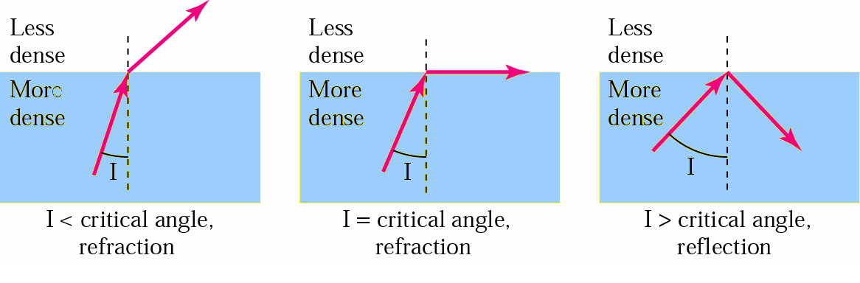
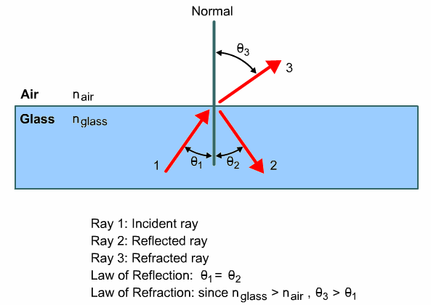
Bending of light ray

Slide 31
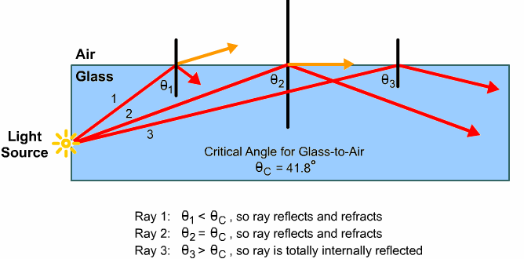
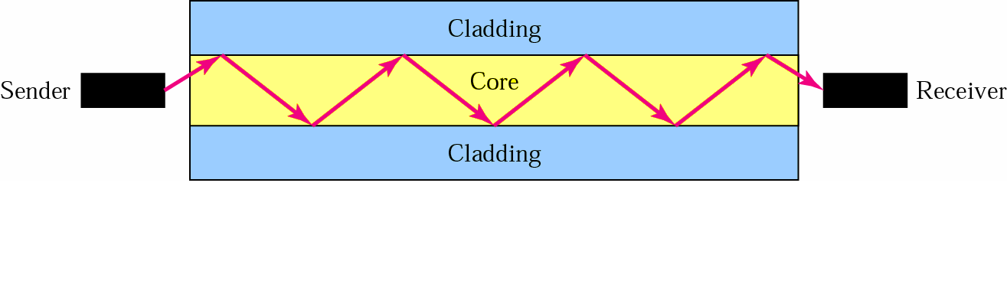
Optical fiber

Slide 32
Optical Fiber - Benefits
Greater capacity
  Data rates of hundreds of Gbps
Smaller size & weight
Lower attenuation
Electromagnetic isolation
Greater repeater spacing
  10s of km at least
Immunity to corrosive materials
More immune to tapping

Slide 33
Challenges
More expensive (usually) than copper media over the same distance (but for a higher capacity)
Different skills and equipment required to terminate and splice the cable infrastructure
More careful handling than copper media

Slide 34
Optical Fiber - Applications
  Long-haul trunks
  - about 1500 km in length & 20,000-60,000 voice channels.
  - undersea optical fiber
  Metropolitan trunks.
  - about 12 km in length & 100,000 voice channels.
  - underground conduits joining telephone exchanges.
  Rural exchange trunks.
  - about 40 – 160 km in length & less than 5000 voice channels.
  Subscriber loops.
  - handling voice, data, image and video.
  LANs.
  - Capacity of 100 Mbps to 1 Gbps.

Slide 35
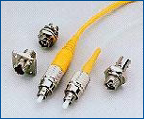
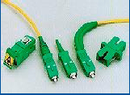
Fiber Optic Cable

Slide 36
Optical Fiber - Transmission Characteristics
Act as wave guide for 10¹⁴ to 10¹⁵ Hz
  Portions of infrared and visible spectrum
Light Emitting Diode (LED)
  Cheaper
  Wider operating temp range
  Last longer
Injection Laser Diode (ILD)
  More efficient
  Greater data rate
Wavelength Division Multiplexing

Slide 37

Figure 7.12 Propagation modes
7.<number>

Slide 38

Figure 7.13 Modes
7.<number>

Slide 39
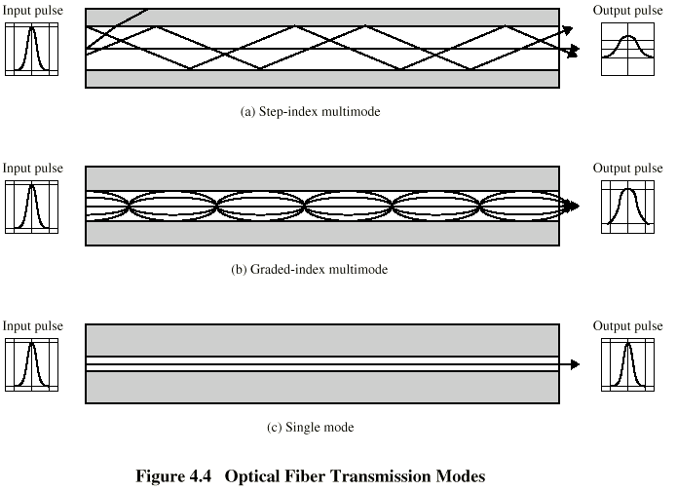
Optical Fiber Transmission Modes
multimode step-index fiber
  the reflective walls of the fiber move the light pulses to the receiver
multimode graded-index fiber
  acts to refract the light toward the center of the fiber by variations in the density
single mode fiber
  the light is guided down the center of an extremely narrow core

Slide 40
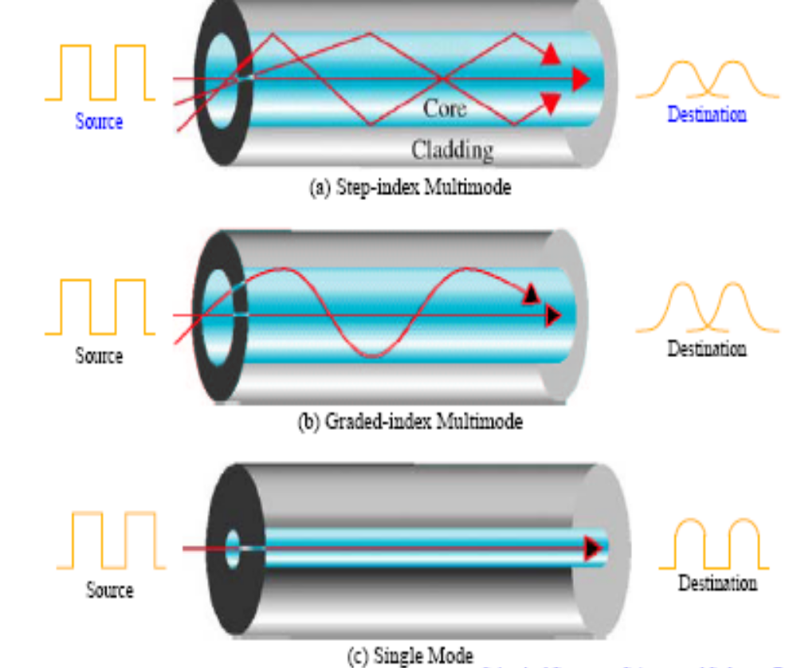
Optical Fiber Transmission Modes

Slide 41
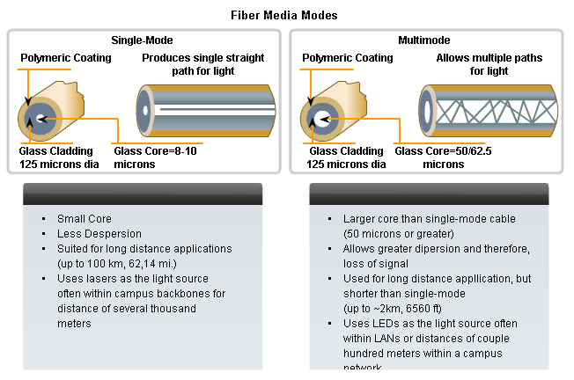
Single Mode Vs Multimode

Slide 42

Table 7.3 Fiber types
7.<number>

Slide 43

Figure 7.14 Fiber construction
7.<number>

Slide 44

Figure 7.15 Fiber-optic cable connectors
7.<number>

Slide 45

Figure 7.16 Optical fiber performance
7.<number>

Slide 46
7-2 UNGUIDED MEDIA: WIRELESS
Unguided media transport electromagnetic waves without using a physical conductor. This type of communication is often referred to as wireless communication.
Topics discussed in this section:
Radio Waves
Microwaves
Infrared
7.<number>

Slide 47

Figure 7.17 Electromagnetic spectrum for wireless communication
7.<number>

Slide 48

Figure 7.18 Propagation methods
7.<number>

Slide 49
Ground propagation
Radio waves travel through the lowest point of the atmosphere, hugging the earth
These low frequency signals emanate in all directions from the transmitting antenna and follow the curvature of the planet
Distance depends on the power of the signal. The greater the power, the greater the distance
7.<number>

Slide 50
Sky propagation
High frequency radio waves radiate upward into the ionosphere where they are reflected back to earth
Allows greater distances with lower output power
7.<number>

Slide 51
Line-of-sight propagation
Very high frequency signals are transmitted in straight lines directly from antenna to antenna
Antennas must be directional, facing each other, and either tall enough or close enough together to not be affected by the curvature of the earth
7.<number>

Slide 52

Table 7.4 Bands
7.<number>

Slide 53

Figure 7.19 Wireless transmission waves
7.<number>

Slide 54
Radio Waves
Waves typically ranging in frequencies between 3kHz and 1 GHz
Omnidirectional
When an antenna propagates radio waves, they are propagated in all directions which can be received by a receiving antenna
Radio waves transmitted by one antenna is susceptible to interference by another antenna that may send signals using the same frequency
7.<number>

Slide 55

Figure 7.20 Omnidirectional antenna
7.<number>

Slide 56
Microwaves
Waves ranging in frequencies between 1GHz and 300 GHz
Microwave propagation is line-of-sight
Very high frequency microwaves can’t penetrate walls
Microwave band is relatively wide
7.<number>

Slide 57

Note
Radio waves are used for multicast communications, such as radio and television, and paging systems.
7.<number>

Slide 58

Figure 7.21 Unidirectional antennas
7.<number>

Slide 59
Note
Microwaves are used for unicast communication such as cellular telephones, satellite networks,
and wireless LANs.
7.<number>

Slide 60
Infrared
Frequencies from 300Ghz to 400THz
High frequencies, cannot penetrate walls
7.<number>

Slide 61
Note
Infrared signals can be used for short-range communication in a closed area using line-of-sight propagation.
7.<number>

